Slide 1
Aws devops Main project-1
BHUPATHI KARTHIK

Slide 2



Deploy 3-tier architecture in aws using terraform

Slide 3
Objective of the project:
The primary goal of this project is to design and deploy a scalable and resilient 3-tier architecture on Amazon Web Services (AWS) using Terraform. The 3-tier architecture comprises a web tier, an application tier, and a database tier, each residing in its dedicated network segment. This setup ensures modularity, scalability, and separation of concerns.

Slide 4
What is terraform?
Terraform is an open-source infrastructure as a code (IAC) tool that allows to create, manage & deploy the production-ready environment. Terraform codifies cloud APIs into declarative configuration files. Terraform can manage both existing service providers and custom in-house solutions

Slide 5
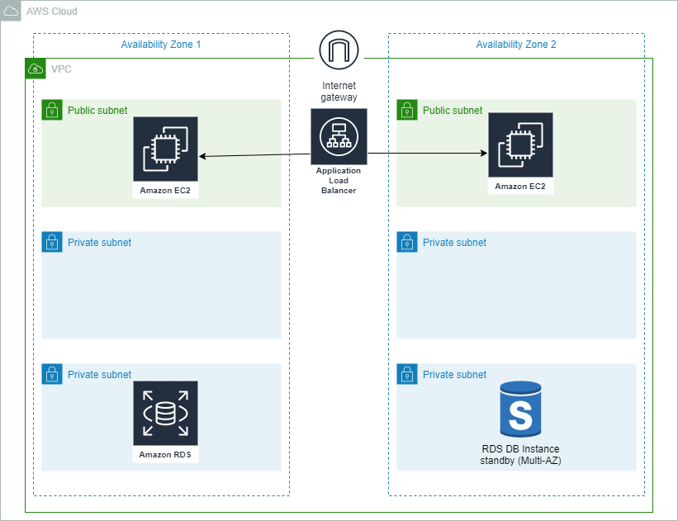
3-tier architecture
The 3-tier architecture is a software architecture pattern that divides an application into three interconnected components or layers, each responsible for a specific set of functionalities. These layers are often referred to as the presentation layer, the business logic layer, and the data storage layer. The main purpose of using a 3-tier architecture is to improve modularity, scalability, and maintainability of a software system.

Slide 6
3-tiers in 3-tier architecture
1.Presentation Tier:
2. Application Tier:
3. Data Base Tier:
Also known as the "front end" or "client tier."
Responsible for presenting information to users and receiving user inputs.
Typically includes the user interface (UI), graphical elements, and user interaction components.
Interfaces with the application tier to request and display data
Often referred to as the "business logic" or "server-side" tier.
Contains the application logic that processes user requests, performs computations, and manages data flow.
Implements business rules and processes to ensure proper application functionality.
Interacts with both the presentation tier and the data tier​​​
Handles data storage, retrieval, and management.
Stores and retrieves data from databases, file systems, or other data storage mechanisms.
Ensures data integrity, security, and consistency.
The data tier is responsible for managing the application's data, and it communicates with the application tier to perform necessary operations.
​

Slide 7
Use of three tier architecture
Scalability: Utilizes Auto Scaling Groups to automatically adjust the number of instances based on demand.
High Availability: Implements multi-AZ deployment for the database tier to ensure availability in case of a failure in one availability zone.
Security: Configures security groups to control inbound and outbound traffic, enforcing the principle of least privilege.
Load Balancing: Implements an Application Load Balancer (ALB) to evenly distribute incoming web traffic across multiple web servers.
Maintainability: Separating the application into distinct tiers makes it easier to troubleshoot, update, and maintain. Each tier can be developed, tested, and updated independently

Slide 8
TOOLS AND TECHNOLOGIES.
AWS Services:
VPC, EC2, RDS, ALB, Auto Scaling, Subnets, Security Groups.
Infrastructure as Code (IaC):
Utilizes Terraform for defining and provisioning AWS infrastructure.
PREREQUISITES:
AWS Account Setup: Create and configure an AWS account to access AWS services.
Tool Installation: Install the AWS CLI and Terraform on your local machine.
IAM User and Permissions: Set up an IAM user with appropriate permissions for Terraform.
Networking Plan: Plan the VPC, subnets, and security groups for your architecture.
Resource Configuration:
Determine AMIs, database configurations, SSH key pairs, and prepare Terraform files for EC2 instances, RDS, and other resources

Slide 9
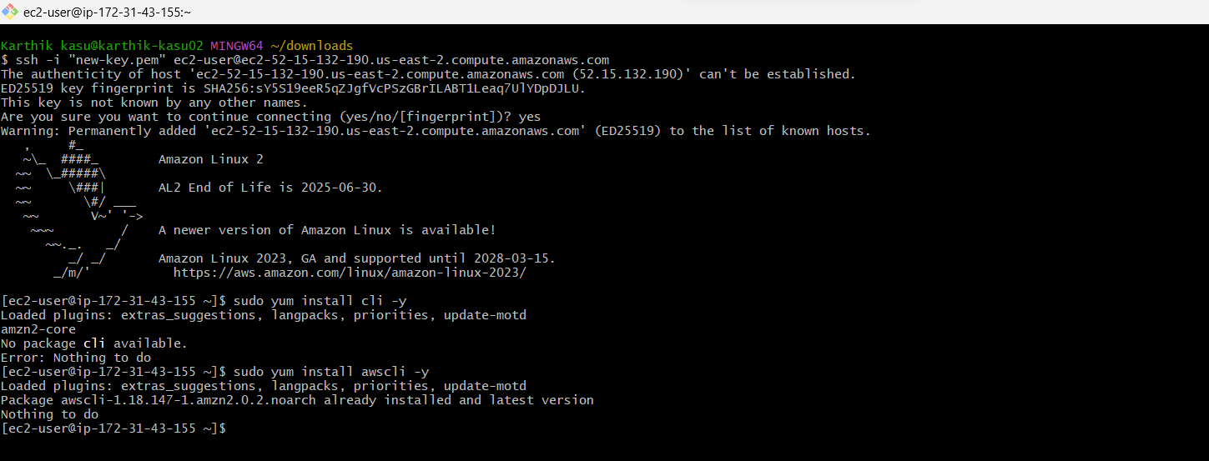
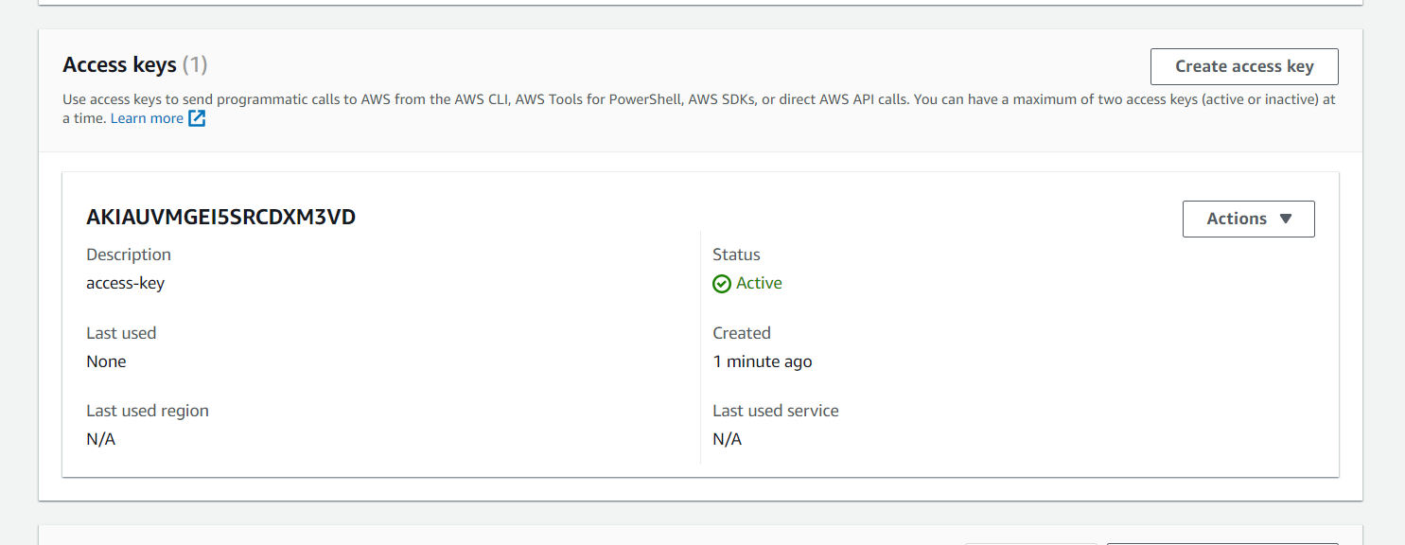
PROCEDURE
First we have to create an instance for terminal where we create our configuration files, and deploy.
Create instance with amazon ami, and t2 micro of instance type, by giving a proper name.
After launching instance we have to login to terminal using ssh.
Again we have to go to aws console and create an access key for our user.
Save the access key and security key for further use.

Slide 10
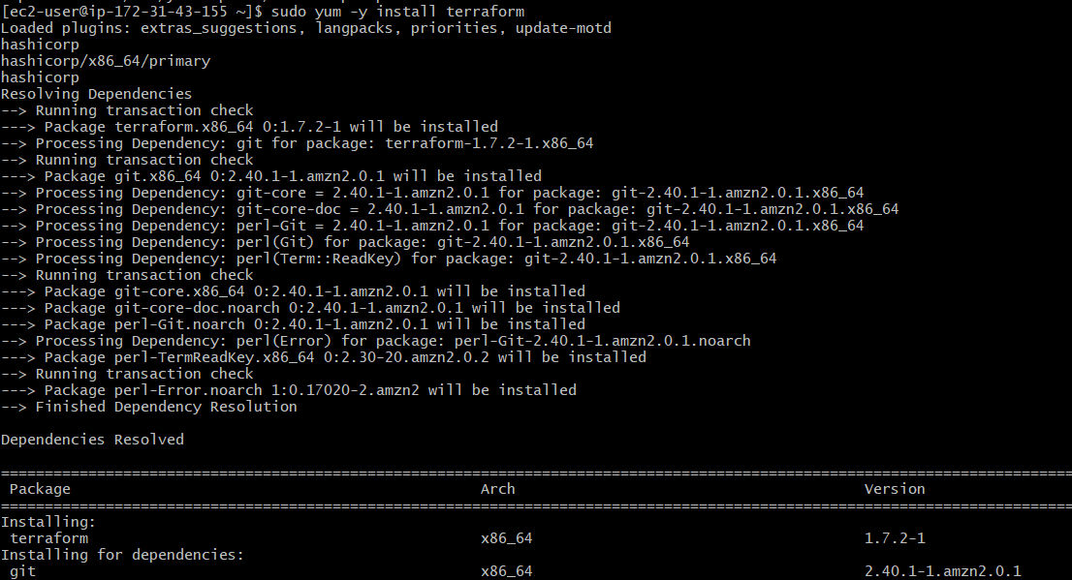
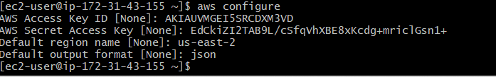
Now we have to install “awscli” using command “sudo yum install awscli -y”.
And install terraform from the harshicorp the link is given below. https://developer.hashicorp.com/terraform/install.
Configure the terminal to define architecture and resource configurations in Terraform configuration files.
In that we have to mention the region where you want to create our resources.
In below you can that we are installed terraform and configured the terminal.

Slide 11
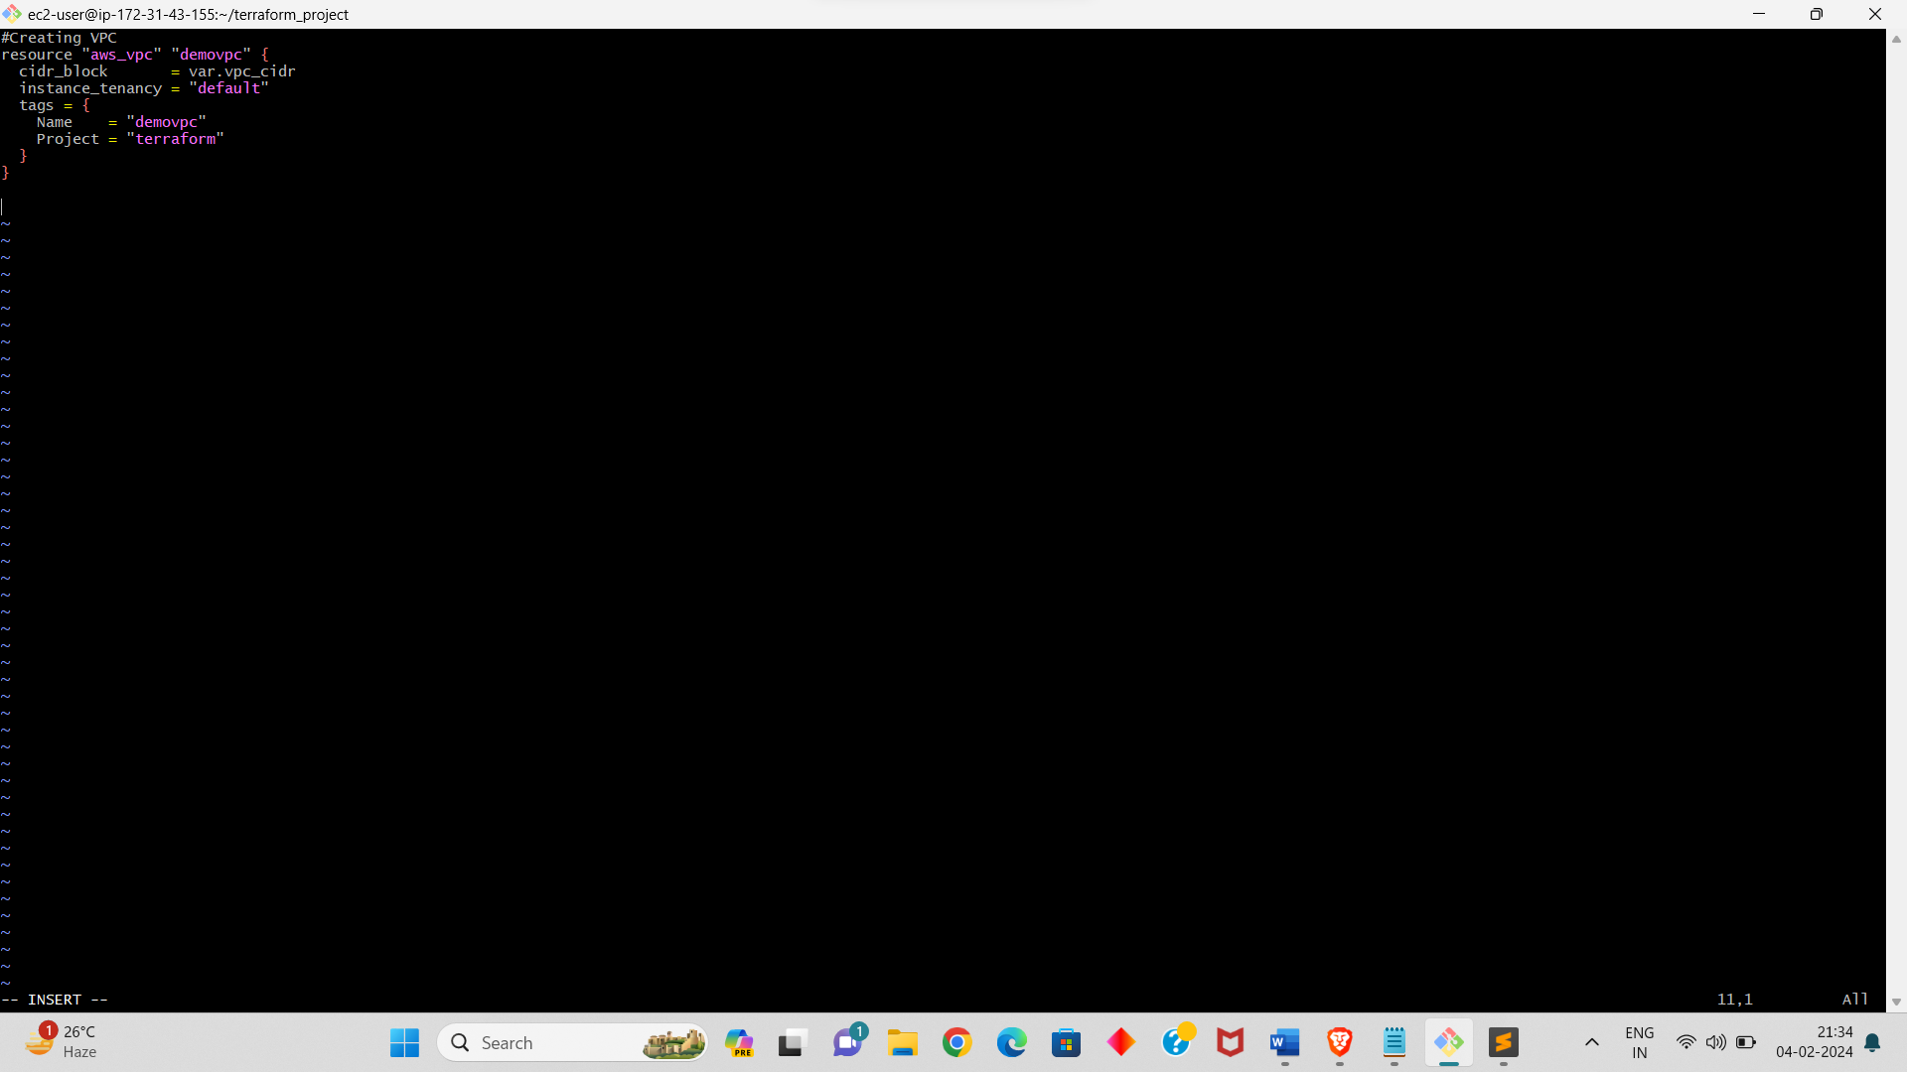
Terraform configuration files:
After login to the terminal, we have to create a directory using “mkdir <name of the directory>”.
Then go into the directory, in that directory we have to create our terraform files.
Create a vpc.tf named configuration file for creating vpc.
In that configuration we have to write script for the vpc like resources we use, name you want to give, etc.,
I will give the script below.
After writing configuration files we have to check whether there is any error or not for that we have to run “terraform fmt” it convert he script into canonical format and style.
Run “terraform validate” for validate the script and it will show if there is any error.
vpc

Slide 12
Terraform configuration files:
Create subnet.tf file for creating subnet, in that we have to mention the resources.
And mention the vpc, availability zones etc.,
We have to create total 6 subnets, 2 for each tier, and give 2 subnets of public for presentation and roaming 4 subnets as private.
Create variable.tf file to declare variables for customizable parameters such as instance types, database configurations, etc.
In that we have to mention about the cidr range also.
Now create a igw.tf configuration file for creating INTERNET GATEWAY.
In that file we have to mention the resource and vpc.

Slide 13
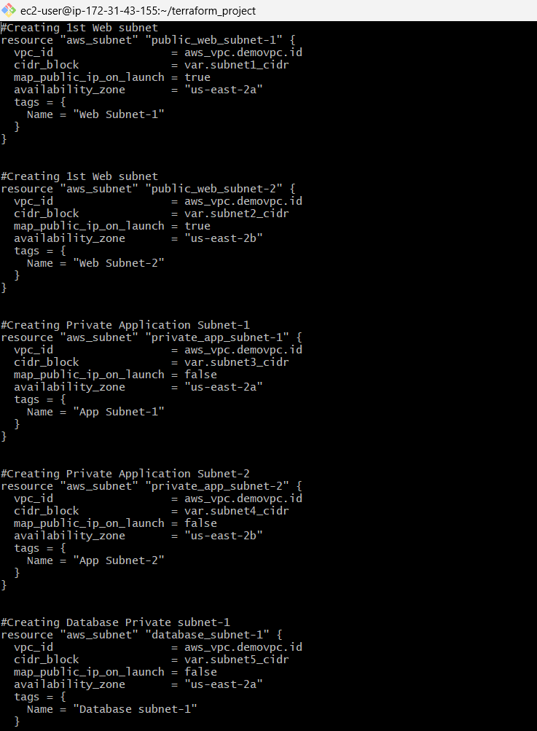
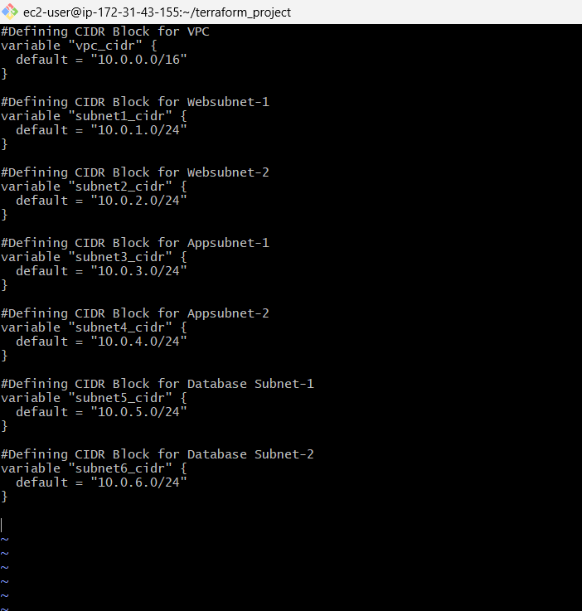
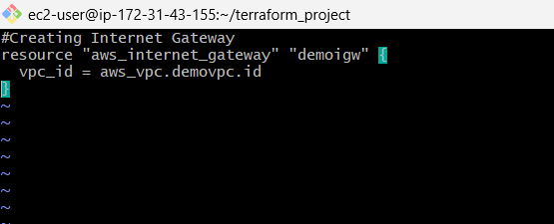
Subnet variables
igw

Slide 14
Terraform configuration files:
Create a routetable.tf file for creating ROUTE TABLE.
The script is given next slide, in that script we give the script for creating route table and associating the route to subnets.
Now create ec2.tf named file for creating EC2 INSTANCES.
In that we have to provide AMI id, instance type, vpc id, subnet id, user data, etc.,
Next we create a keypair.tf named file for path for the key pair.
In that file we mention the public key file path, which we created the key pair in the terminal using command.
“ssh-keygen -t rsa -b 2048 -f instance-key”.
Now we have to create a file data1.sh, data2.sh.
In that file we have to write the commands that we want execute our instances we created.
The script is about installing httpd and git, start and enable the httpd, and git clone.

Slide 15
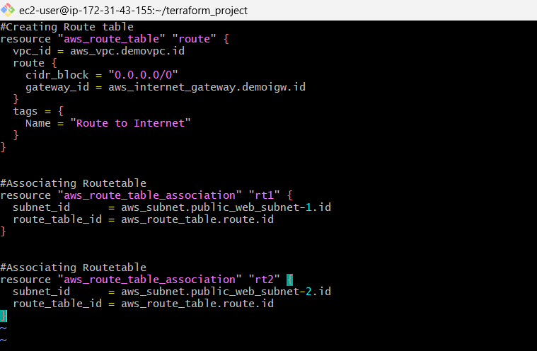
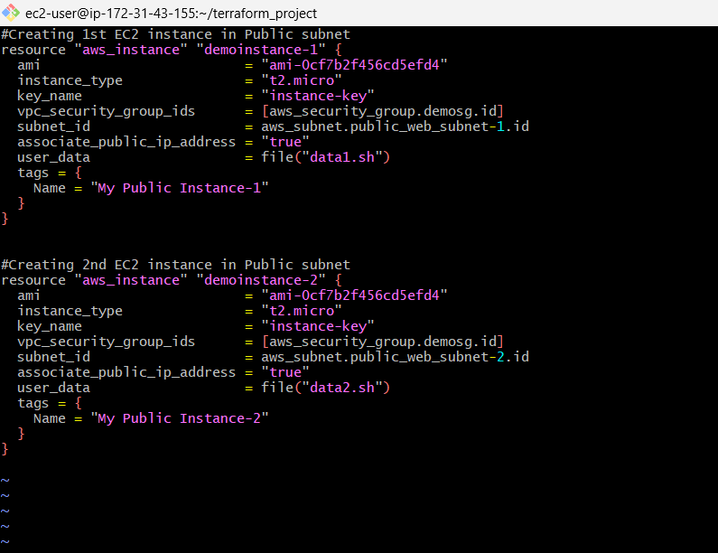
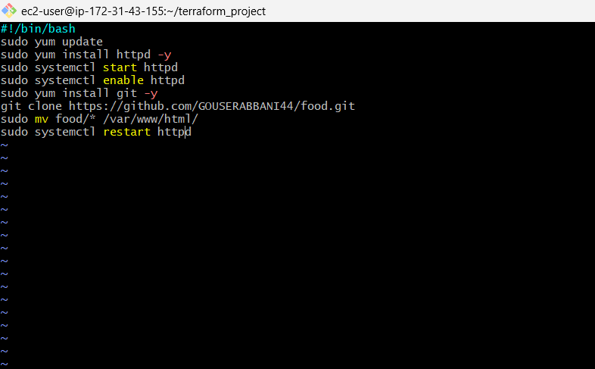
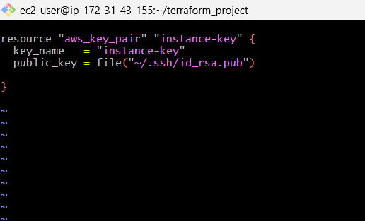
Route table
ec2
Key pair
igw

Slide 16
Terraform configuration files:
Now create a terraform file for creating SECURITY GROUP of our instance. File name ec2sg.tf.
In that file we have to give scripts for the inbound and out bound rules.
And give the form and to ports and the cidr blocks also.
Next we have to create a terraform file elb.tf for creating LOAD BALANCE AND TARGET GROUP.
In that we have to mention the attachments for target group and load balancer.
And we have to create script for listener also.
Give port Forword to the target group.

Slide 17
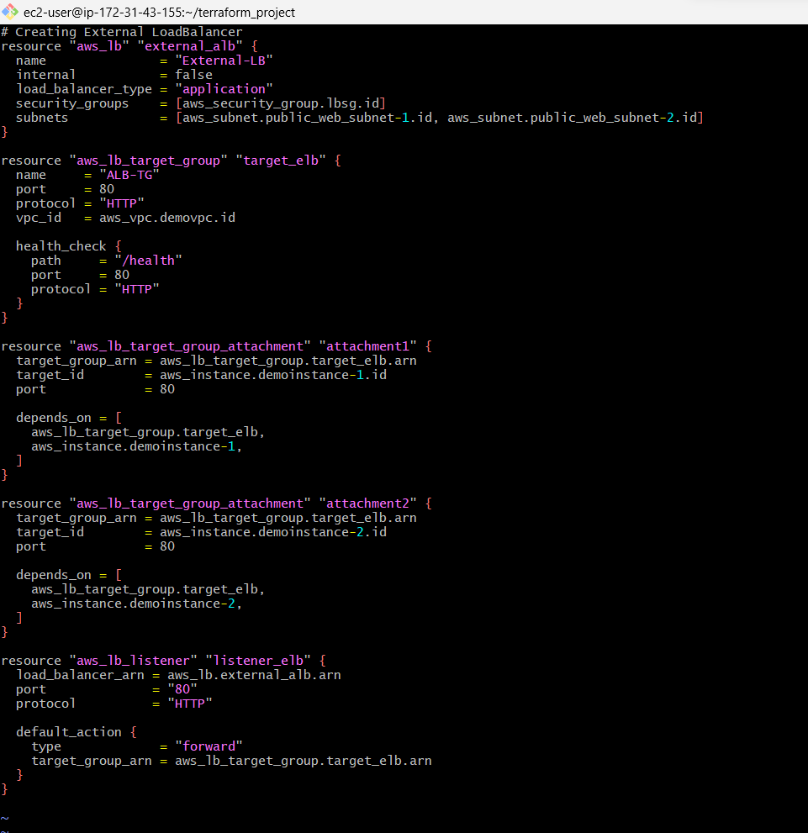
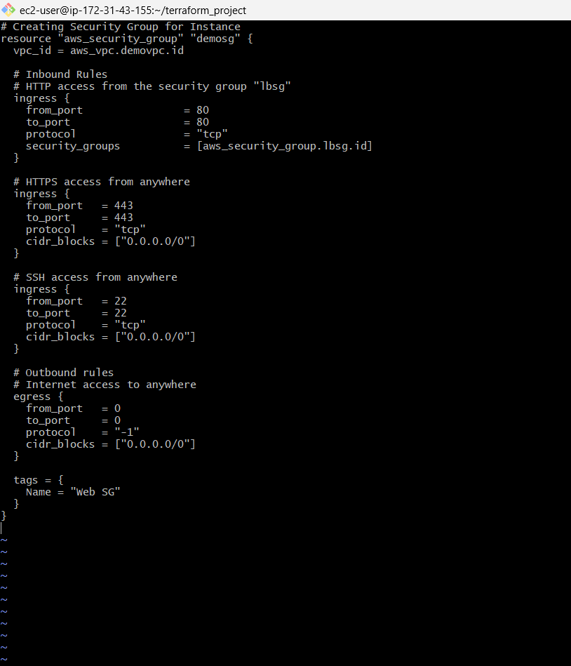
instance sg
ELB

Slide 18
Now create a lgsg.tf file for creating LOADBALANCER SECURITY GROUP.
Write the script in that file.
That file consists of the script of inbound and outbound rules of load balancer sg.
Now create a terraform asg.tf file for create AUTO SCALING AND LAUCH CONFIGURATION.
In that we mention the script for creating LC with name, ami id, instance type, and security group.
You have to write the below script for that mentioned.
We also added script for attaching auto scaling to load balancer also.
And added the health check type, and health check grace period.
Don’t forgot to run the format and validate command to check the errors after create each terraform file.
This helps you at the final apply part.

Slide 19
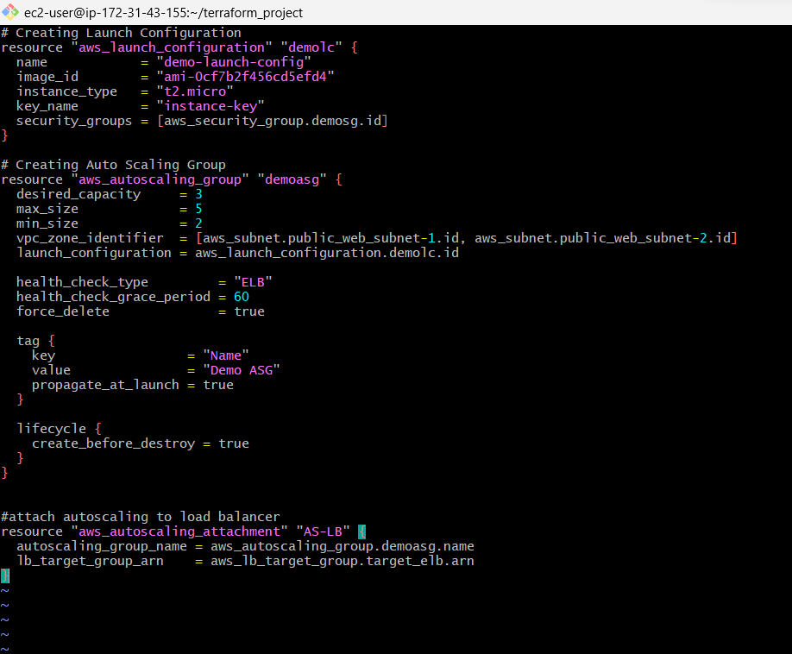
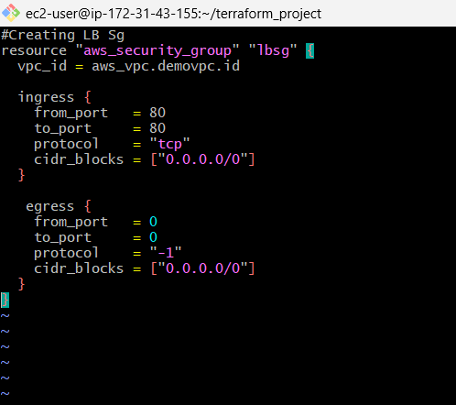
Asg & Lc
Lb sg

Slide 20
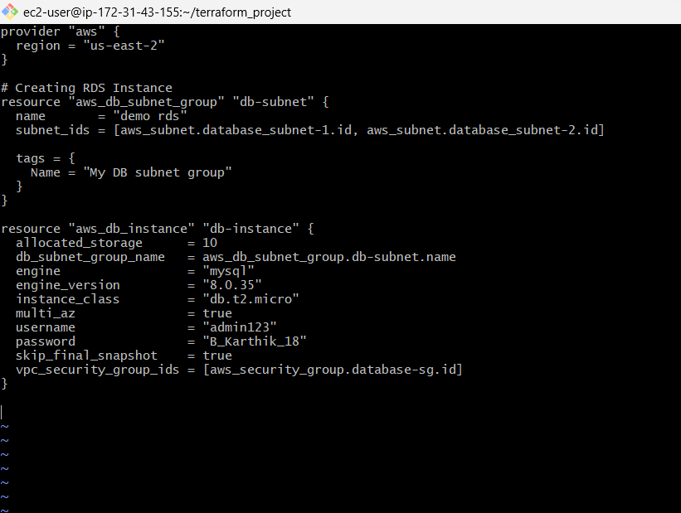
Now create a terraform file named rds.tf file for creating RDS instance and subnet for RDS.
The rds instance is created in a private subnet.
In that we have to give the database engine, engine version.
And give the username and password for our database.
Store you username and password for opening in the terminal.

Slide 21
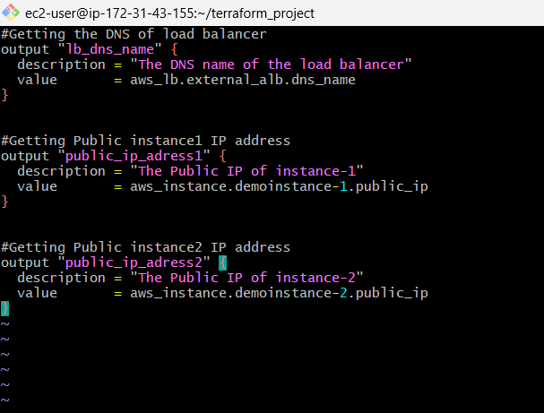
Terraform configuration files:
Create a terraform file of outputs.tf this file is out outputs.
Write the script that mentioned in the outputs.tf file.
In this file we mention the output script for DNS of Load balancer, and public id of our two instances that we created.
This file gives the outputs after we created the aws architecture.

Slide 22
Deployment steps:
After writing all the terraform files, we have to format the files using “terraform fmt”
By executing this the files will convert into canonical format and style.
Execute “terraform validate” to validate the files.
Execute “terraform plan” to preview changes and understand the resources that will be created.
Execute “terraform apply” to provision AWS resources based on the defined configuration.
Then we have to give you for creating resources.
After some time all the resources are crated and the output will be displayed, in that output the DNS link of load balancer is give.
Copy that link and browse it in the browser, the application will be hosted, when we refresh multiple times, the two application will be shuffled.

Slide 23
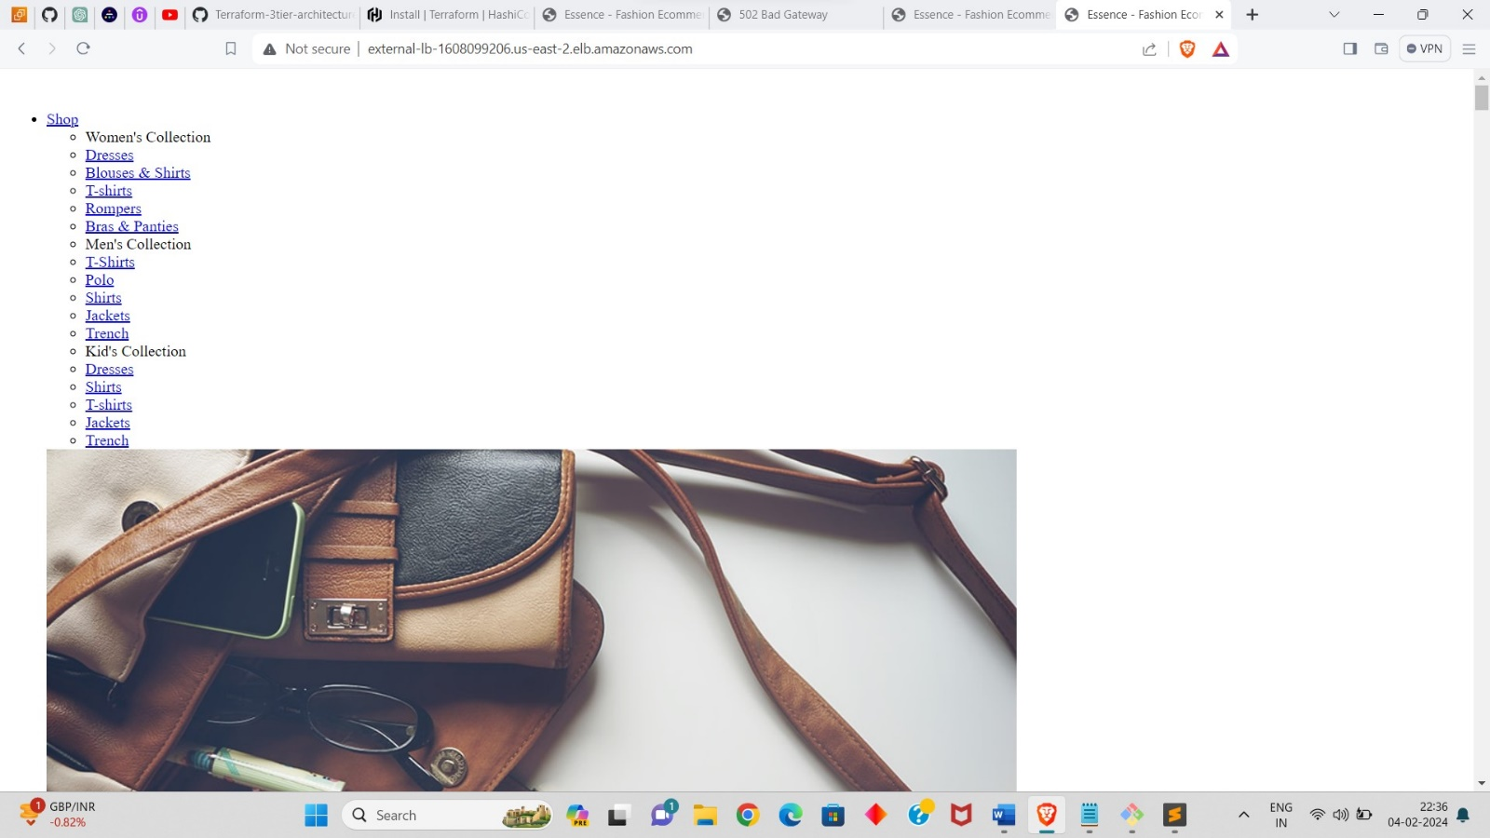
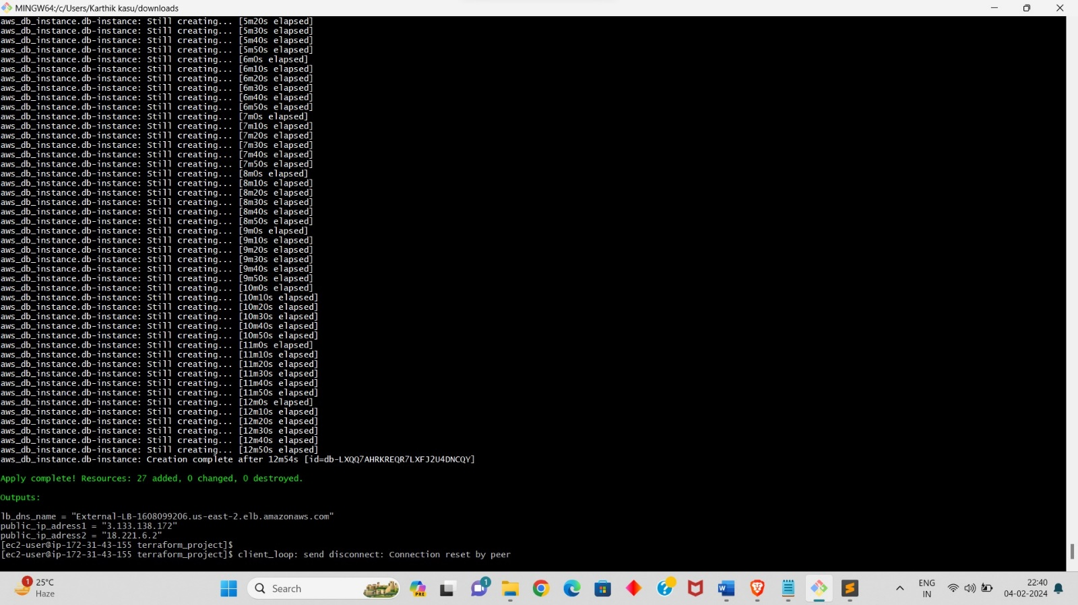
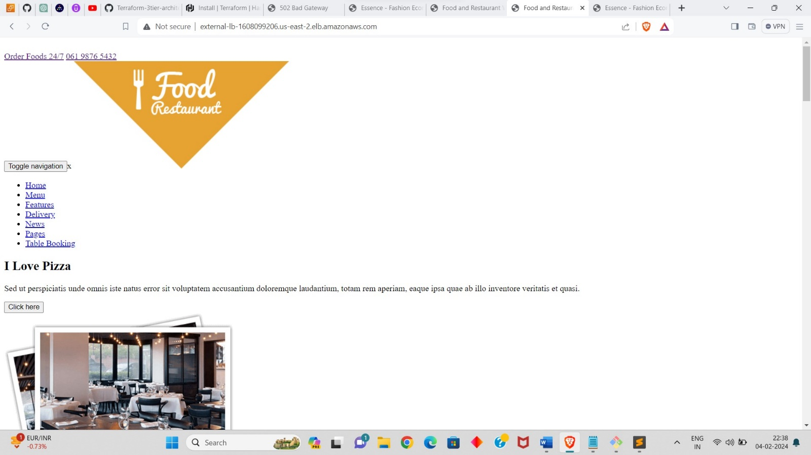
Out put
Applications

Slide 24
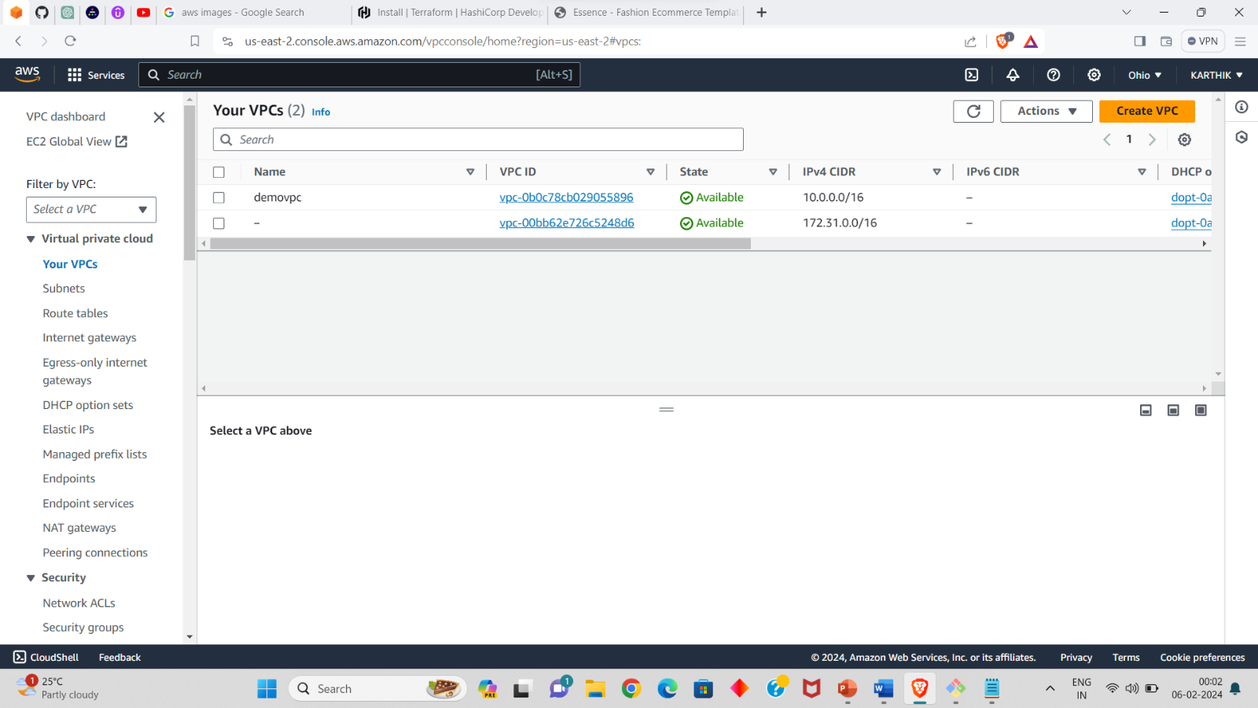
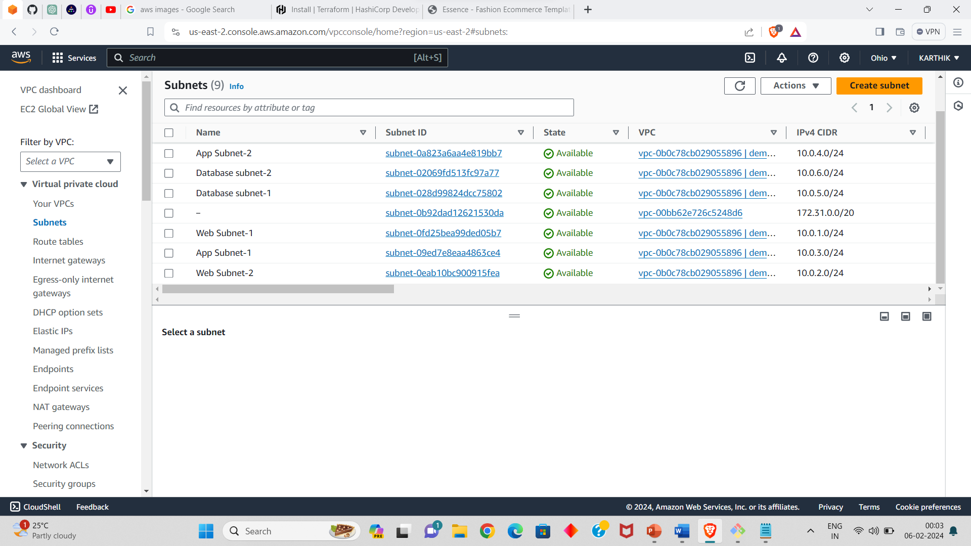
Resources created in aws:
DEMO NAMED VPC
SUBNETS

Slide 25
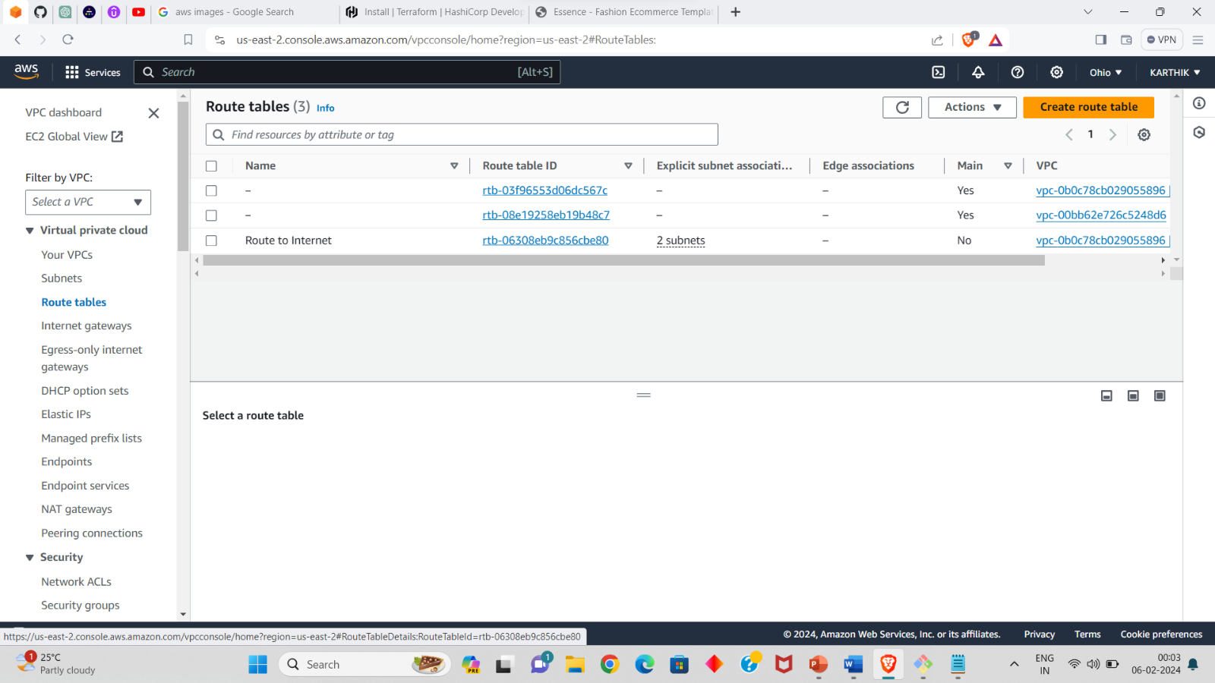
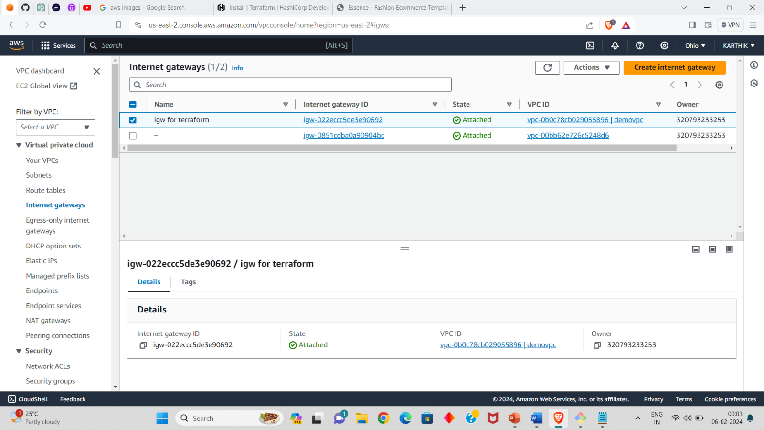
Resources created in aws:
ROUTE TABLE
INTERNET GATEWAY

Slide 26
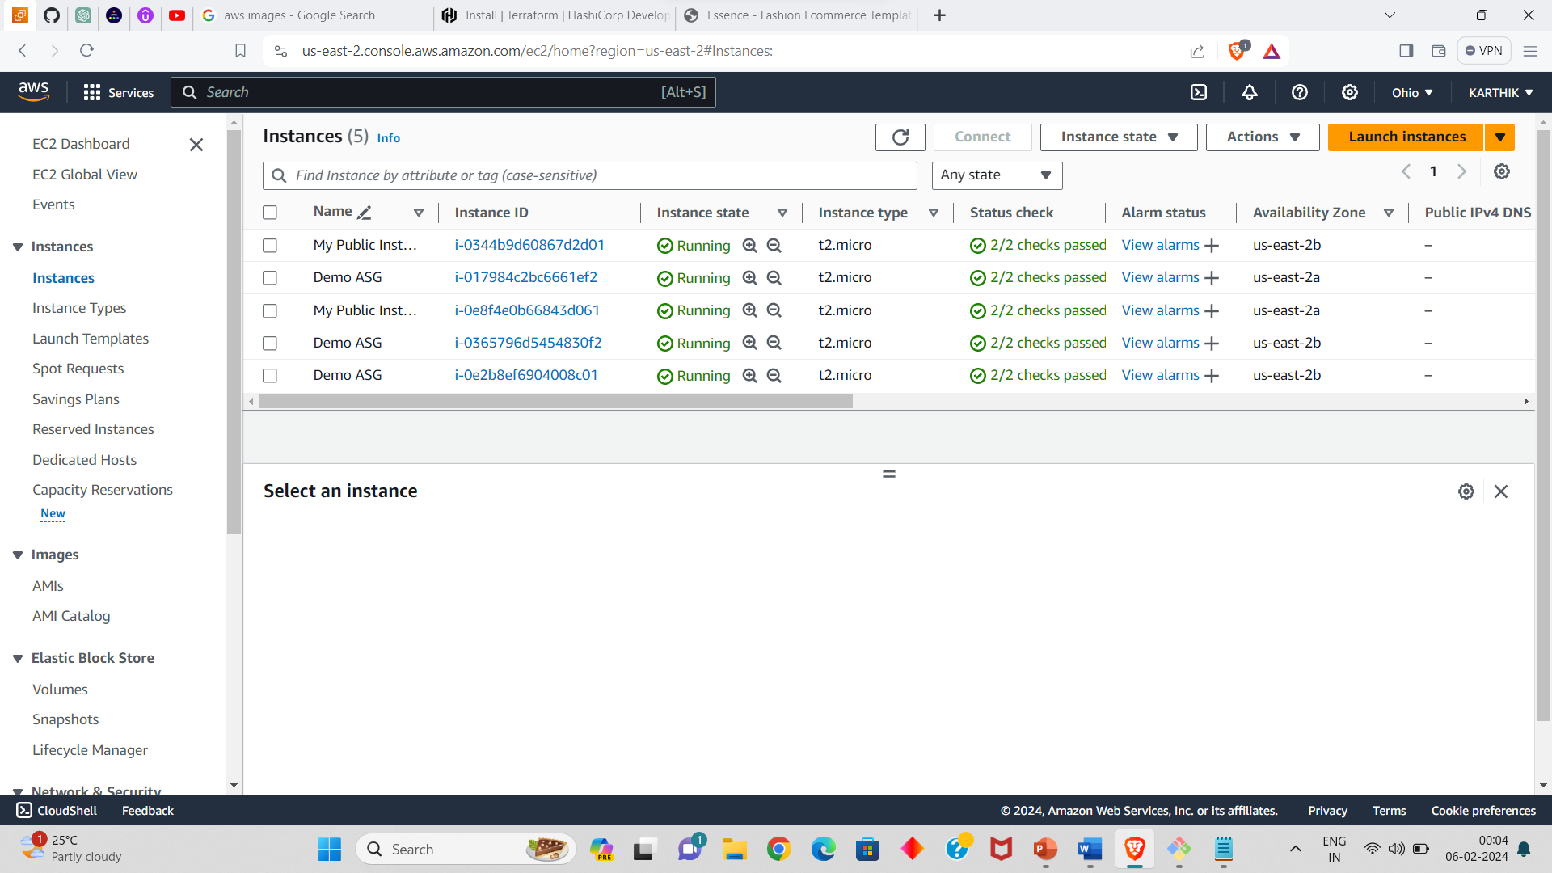
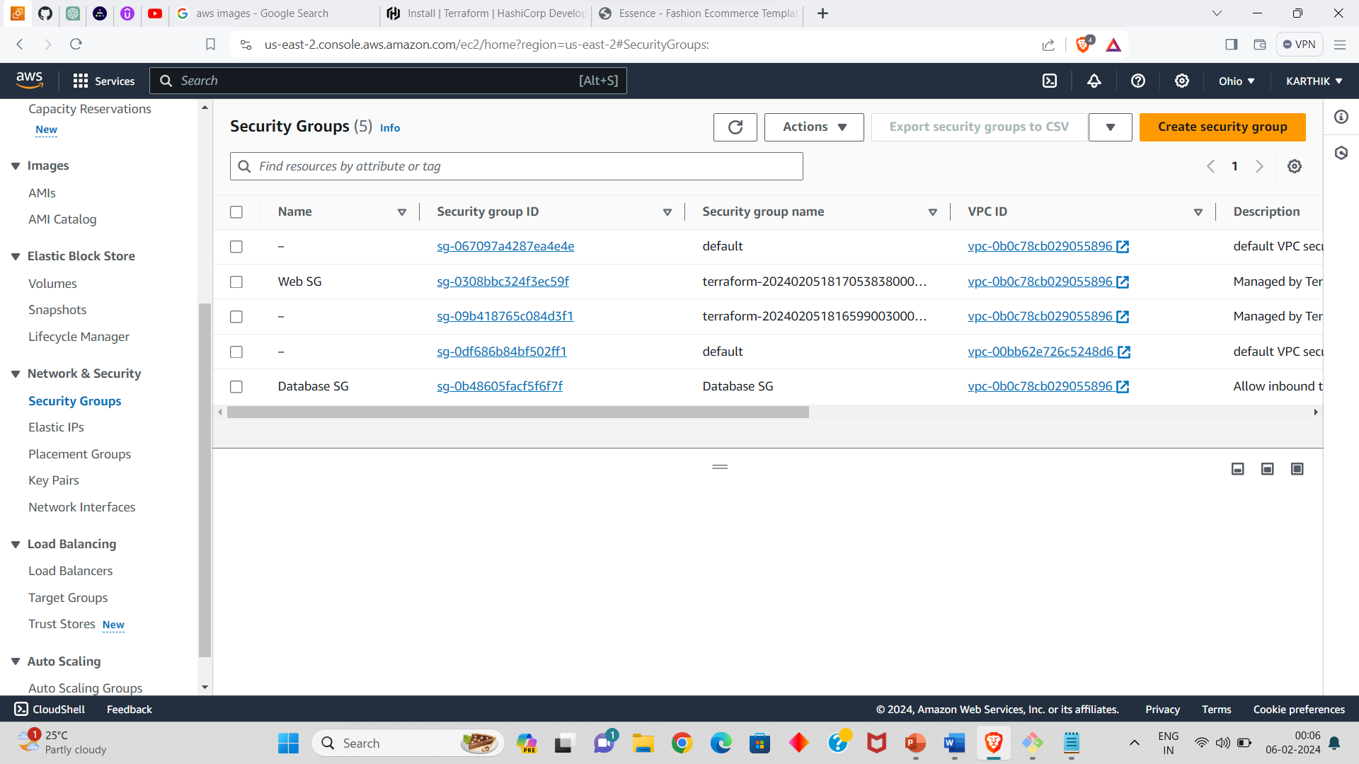
Resources created in aws:
INSTANCES
SECURITY GROUPS

Slide 27
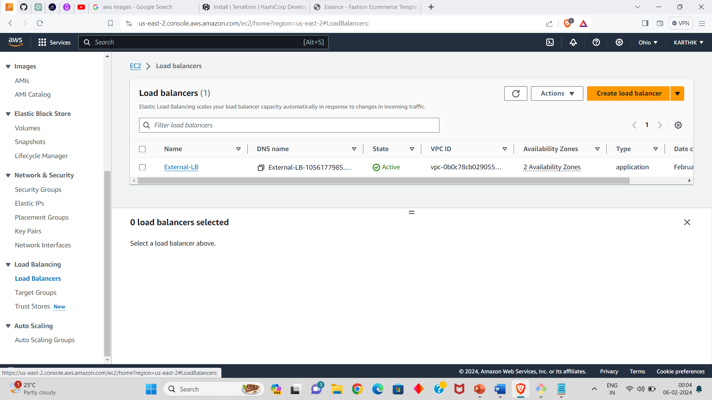
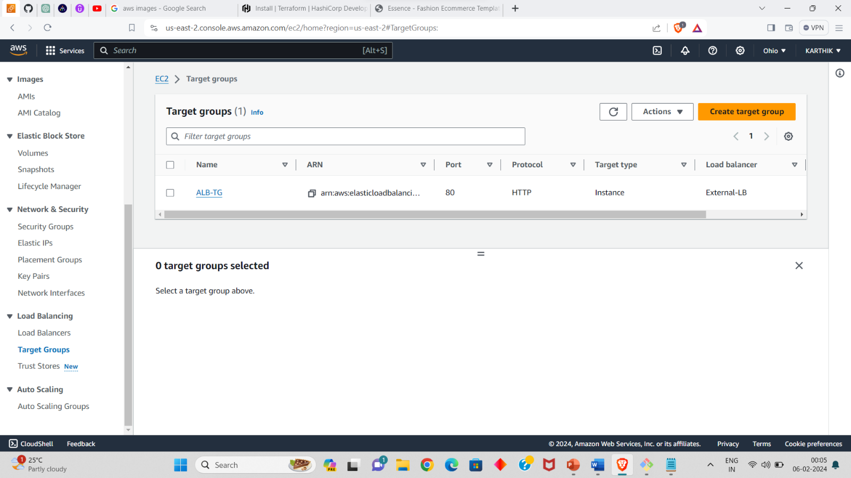
Resources created in aws:
LOAD BALANCER
TARGET GROUP

Slide 28
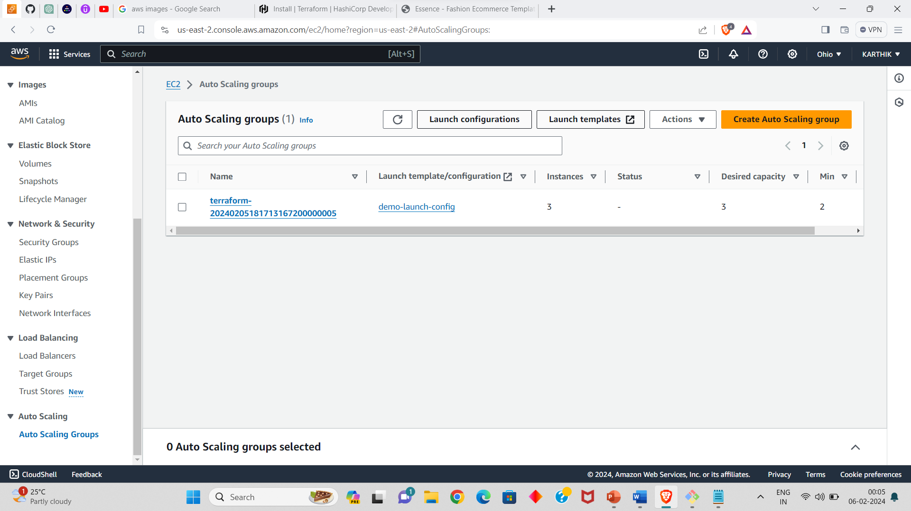
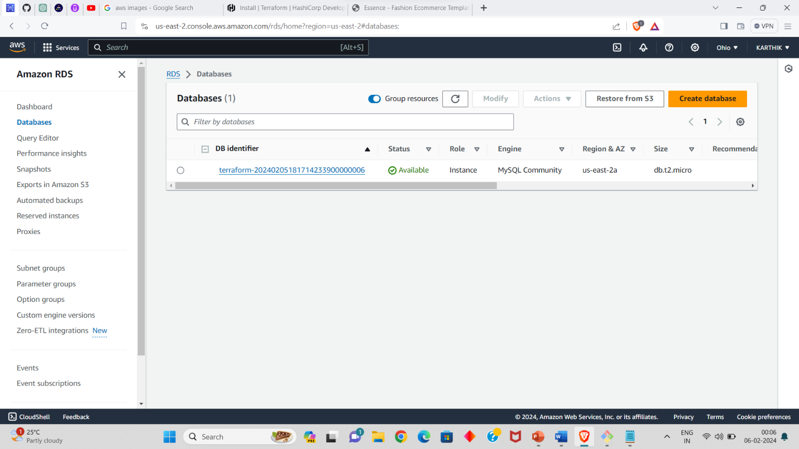
Resources created in aws:
AUTO SCALING GROUP
DATABASE

Slide 29
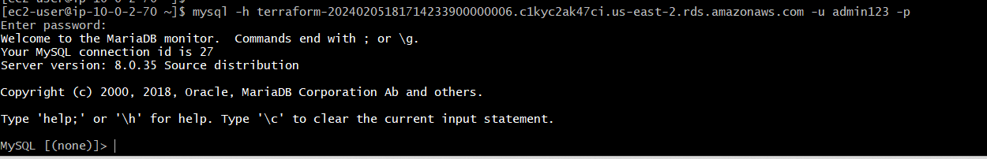
DATABASE CONNECTED TO EC2
RESOURCE LINK:
Here is the link of my GITHUB repository, you can get the scripts of the resources that we created above.
https://github.com/KARTHIK0418/terraform_project.git

Slide 30
THANK YOU
BHUPATHI KARTHIK

